Slide 1
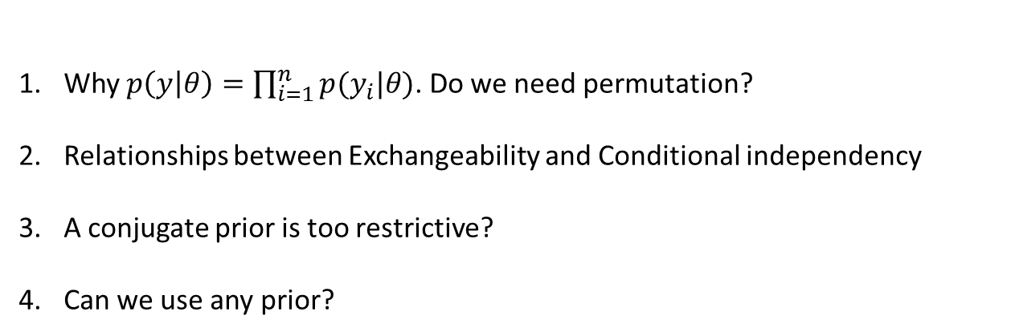
Questions from the previous lecture
Why $p\left(y | θ\right)=\prod_{i=1}^{n}{p(y_{i}|θ)}$. Do we need permutation?
Relationships between Exchangeability and Conditional independency
A conjugate prior is too restrictive?
Can we use any prior?

Slide 2

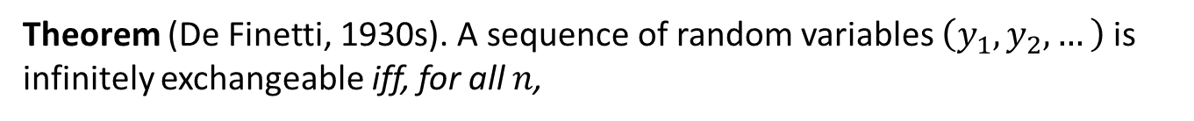


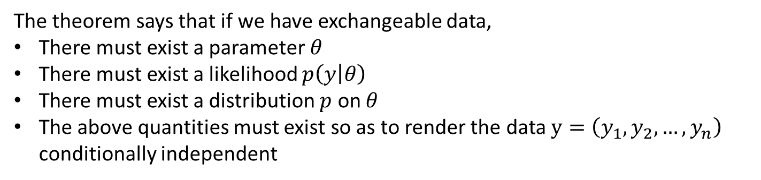
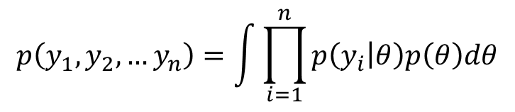

Theorem (De Finetti, 1930s). A sequence of random variables $\left(y_{1}, y_{2},…\right)$ is infinitely exchangeable iff, for all $n$,
$$p\left(y_{1}, y_{2},…y_{n}\right)=\int{\prod_{i=1}^{n}{p\left(y_{i} | θ\right)p\left(θ\right)dθ}}$$
$$θ$$
$$y_{1}$$
$$y_{2}$$
$$y_{n}$$
The theorem says that if we have exchangeable data,
There must exist a parameter $θ$
There must exist a likelihood $p\left(y | θ\right)$
There must exist a distribution $p$ on $θ$
The above quantities must exist so as to render the data $y=\left(y_{1},y_{2},…, y_{n}\right)$ conditionally independent
Prior (Bayesian approach) is suggested by the data being exchangeable

Slide 3
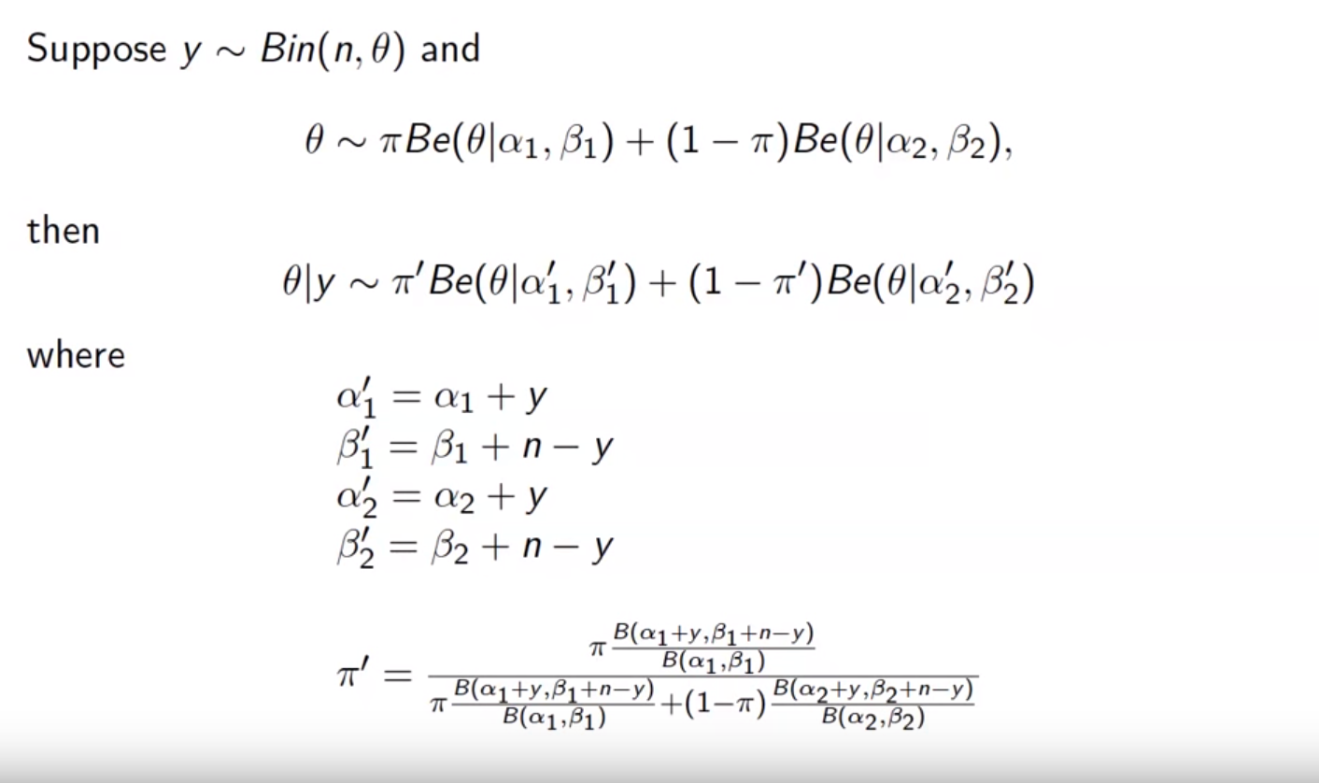
Screen shot from the lecture from : https://www.youtube.com/watch?v=yhewYFqGjFA&index=6&list=PLFHD4aOUZFp0Xhzd5j1nWnExD54xJfnJX

Slide 4
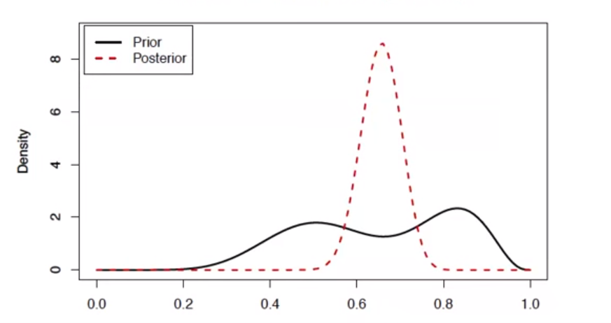

Slide 5
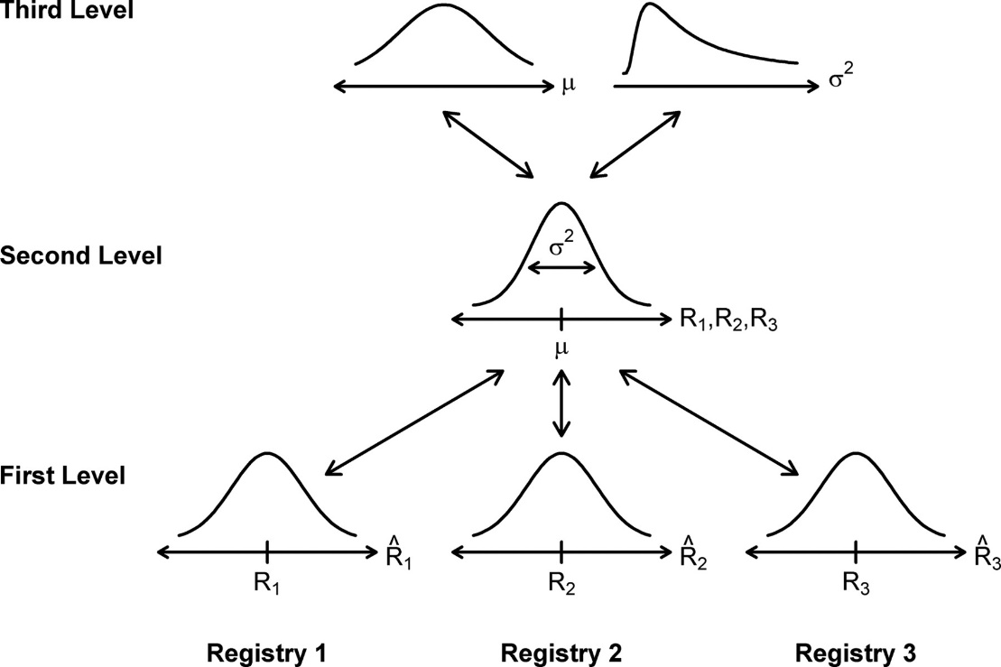
L4. Hierarchical Bayesian models

Slide 6

Why Hierarchical models?
Seasons | Made | Attempts
2012-2013 | 25 | 46
2013-2014 | 41 | 93
2014-2015 | 93 | 176
2015-2016 | 79 | 120
Is his free-throw percentage higher this year than past years?

Slide 7


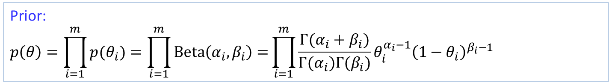



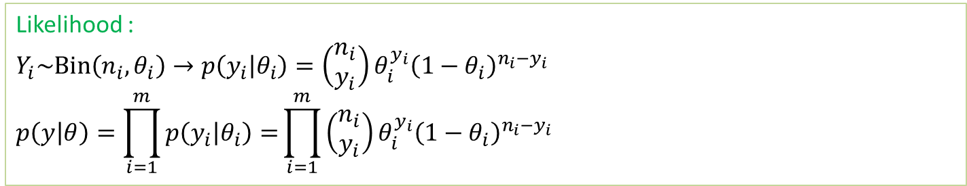









Why Hierarchical models?
Likelihood :
$$Y_{i}\sim Bin\left(n_{i},θ_{i}\right)→p\left(y_{i} | θ_{i}\right)=\left(\begin{aligned}n_{i} \\ y_{i}\end{aligned}\right)θ_{i}^{y_{i}}{\left(1−θ_{i}\right)}^{n_{i}−y_{i}}$$
$$p\left(y | θ\right)=\prod_{i=1}^{m}{p\left(y_{i} | θ_{i}\right)=}\prod_{i=1}^{m}{\left(\begin{aligned}n_{i} \\ y_{i}\end{aligned}\right)θ_{i}^{y_{i}}{\left(1−θ_{i}\right)}^{n_{i}−y_{i}}}$$
Prior:
$$p\left(θ\right)=\prod_{i=1}^{m}{p(θ_{i})=\prod_{i=1}^{m}{Beta\left(α_{i},β_{i}\right)=}}\prod_{i=1}^{m}{\frac{Γ(α_{i}+β_{i})}{Γ(α_{i})Γ(β_{i})}θ_{i}^{α_{i}−1}{\left(1−θ_{i}\right)}^{β_{i}−1}}$$
$${ α}_{1},β_{1}$$
$${ α}_{2},β_{2}$$
$$⋯$$
$${ α}_{m},β_{m}$$
$${ θ}_{1}$$
$$θ_{2}$$
$$⋯$$
$$θ_{m}$$
$$θ=\left({ θ}_{1},…,{ θ}_{m}\right)$$
$${ y}_{1}$$
$${ y}_{2}$$
$$⋯$$
$${ y}_{m}$$
$$y=\left({ y}_{1},…,{ y}_{m}\right)$$

Slide 8
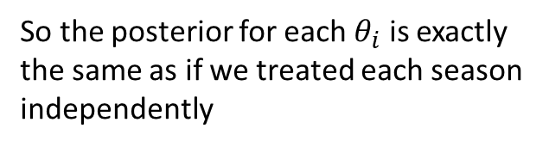


Why Hierarchical models?
Likelihood :
$$Y_{i}\sim Bin\left(n_{i},θ_{i}\right)→p\left(y_{i} | θ_{i}\right)=\left(\begin{aligned}n_{i} \\ y_{i}\end{aligned}\right)θ_{i}^{y_{i}}{\left(1−θ_{i}\right)}^{n_{i}−y_{i}}$$
$$p\left(y | θ\right)=\prod_{i=1}^{m}{p\left(y_{i} | θ_{i}\right)=}\prod_{i=1}^{m}{\left(\begin{aligned}n_{i} \\ y_{i}\end{aligned}\right)θ_{i}^{y_{i}}{\left(1−θ_{i}\right)}^{n_{i}−y_{i}}}$$
Prior:
$$p\left(θ\right)=\prod_{i=1}^{m}{p(θ_{i})=\prod_{i=1}^{m}{Beta\left(α_{i},β_{i}\right)=}}\prod_{i=1}^{m}{\frac{Γ(α_{i}+β_{i})}{Γ(α_{i})Γ(β_{i})}θ_{i}^{α_{i}−1}{\left(1−θ_{i}\right)}^{β_{i}−1}}$$
Posterior :
$$P(θ|y)$$
$$∝P\left(y | θ\right)p\left(θ\right)$$
$$=\prod_{i=1}^{m}{p\left(y_{i} | θ_{i}\right)}\prod_{i=1}^{m}{p(θ_{i})}$$
$$=\prod_{i=1}^{m}{p\left(y_{i} | θ_{i}\right)}p(θ_{i})$$
$$=\prod_{i=1}^{m}{Beta\left(θ_{i}|α_{i}+y_{i},β_{i}+n_{i}−y_{i}\right) }$$
So the posterior for each $θ_{i}$ is exactly the same as if we treated each season independently

Slide 9
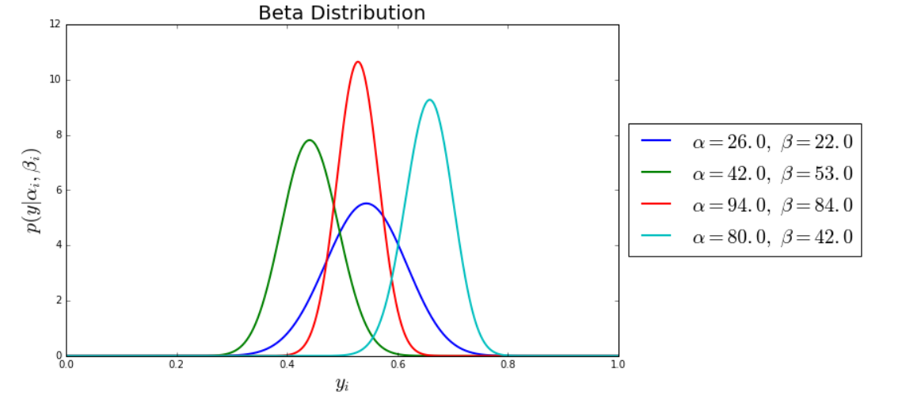
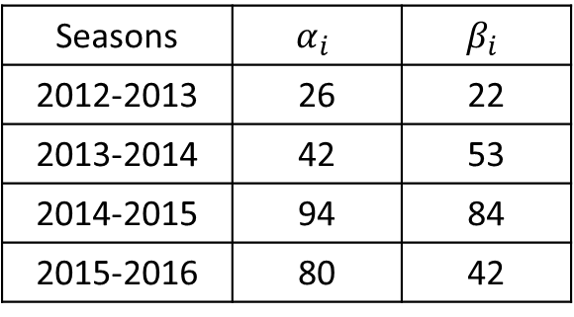
Why Hierarchical models?
Assuming $θ_{i}\sim Beta\left(α_{i}=1,β_{i}=1\right)$ for all $i$, results in independent Beta posterior
Seasons | Made | Attempts
2012-2013 | 25 | 46
2013-2014 | 41 | 93
2014-2015 | 93 | 176
2015-2016 | 79 | 120
Seasons | $$α_{i}$$ | $$β_{i}$$
2012-2013 | 26 | 22
2013-2014 | 42 | 53
2014-2015 | 94 | 84
2015-2016 | 80 | 42
Is there any way to use the data from the previous seasons for estimating the success probability for the current season?

Slide 10



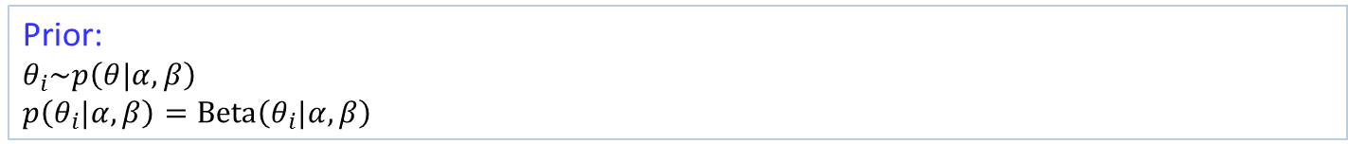





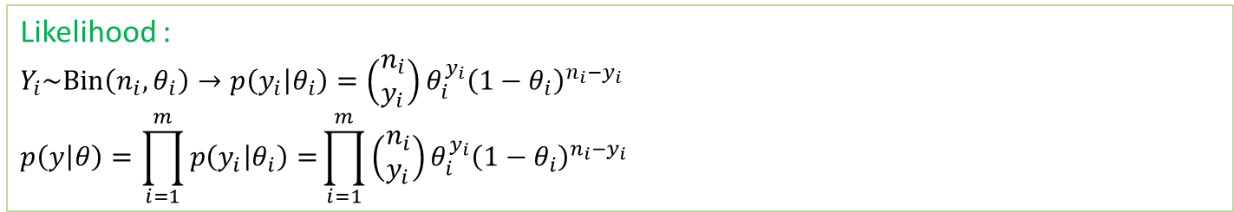






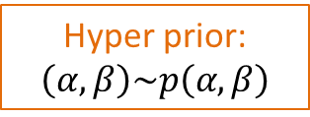







Why Hierarchical models?
Likelihood :
$$Y_{i}\sim Bin\left(n_{i},θ_{i}\right)→p\left(y_{i} | θ_{i}\right)=\left(\begin{aligned}n_{i} \\ y_{i}\end{aligned}\right)θ_{i}^{y_{i}}{\left(1−θ_{i}\right)}^{n_{i}−y_{i}}$$
$$p\left(y | θ\right)=\prod_{i=1}^{m}{p\left(y_{i} | θ_{i}\right)=}\prod_{i=1}^{m}{\left(\begin{aligned}n_{i} \\ y_{i}\end{aligned}\right)θ_{i}^{y_{i}}{\left(1−θ_{i}\right)}^{n_{i}−y_{i}}}$$
Prior:
$$θ_{i}\sim p\left(θ|α, β\right)$$
$$p\left(θ_{i}|α, β\right)=Beta\left(θ_{i}|α,β\right)$$
Hyper prior:
$$\left(α, β\right)\sim p\left(α, β\right)$$
Fixed $α, β$
Fully Bayesian
$$α, β$$
$$α, β$$
$${ θ}_{1}$$
$$θ_{2}$$
$$⋯$$
$$θ_{m}$$
$$θ=\left({ θ}_{1},…,{ θ}_{m}\right)$$
$${ θ}_{1}$$
$$θ_{2}$$
$$⋯$$
$$θ_{m}$$
$${ y}_{1}$$
$${ y}_{2}$$
$$⋯$$
$${ y}_{m}$$
$$y=\left({ y}_{1},…,{ y}_{m}\right)$$
$${ y}_{1}$$
$${ y}_{2}$$
$$⋯$$
$${ y}_{m}$$

Slide 11




Why Hierarchical models?
Survival probability of cardiac patients $θ_{1}$
$$θ_{1}$$
$y_{11},y_{21}$,…, $y_{n1}$

Slide 12





Why Hierarchical models?
Survival probability of cardiac patients
$θ_{j}\sim$ $population distribution$
$$θ_{1}$$
$$θ_{2}$$
$$θ_{j}$$
$y_{11},y_{21}$,…, $y_{n1}$
$y_{12},y_{22}$,…, $y_{n2}$
$y_{1j},y_{2j}$,…, $y_{nj}$
Population distribution is used to structure some dependence into the parameters, thereby avoiding problems of overfitting
It is natural to model such a problem hierarchically, with observable outcomes modeled conditionally on certain parameters, which themselves are given a probabilistic specification in terms of further parameters, known as hyper-parameters
Such hierarchical thinking helps in understanding multi-parameter problems and also plays an important role in developing computational strategies

Slide 13
Why Hierarchical models?
Nonhierarchical models
With too small parameters, a model cannot fit large data set
→Large Bias
With too many parameters, a model over fit data set
→Poor generalization
Hierarchical models:
Can have enough parameters to fit the data well
Uses population distribution to structure some dependencies into the parameters
Prior knowledge can be encoded into hierarchical structure
Advantageous when only a small data set is available
Avoid problems of overfitting

Slide 14
Motivating example : New drug test
Current experimental result
4 success from 14 tests
What is the probability of success?
$\frac{4}{14}=28.6\%$
It seems that we only have very small data set

Slide 15
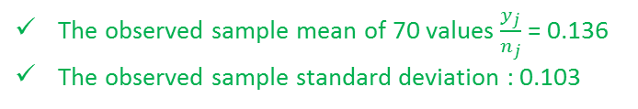
Motivating example : New drug test
Current experimental result
4 success from 14 tests
Historical experimental results
0/20 | 0/20 | 0/20 | 0/20 | 0/20 | 0/20 | 0/20 | 0/19 | 0/19 | 0/19
0/19 | 0/18 | 0/18 | 0/17 | 1/20 | 1/20 | 1/20 | 1/20 | 1/19 | 1/19
1/18 | 1/18 | 2/25 | 2/24 | 2/23 | 2/20 | 2/10 | 2/20 | 2/20 | 2/20
2/20 | 1/10 | 5/49 | 2/19 | 5/46 | 3/27 | 2/17 | 7/49 | 7/47 | 3/20
3/20 | 2/13 | 9/48 | 10/50 | 4/20 | 4/20 | 4/20 | 4/20 | 4/20 | 4/20
4/20 | 10/48 | 4/19 | 4/19 | 4/19 | 5/22 | 11/46 | 12/49 | 5/20 | 5/20
6/23 | 5/19 | 6/22 | 6/20 | 6/20 | 6/20 | 16/52 | 15/47 | 15/46 | 9/24
The observed sample mean of 70 values $\frac{y_{j}}{n_{j}}$ = 0.136
The observed sample standard deviation : 0.103

Slide 16
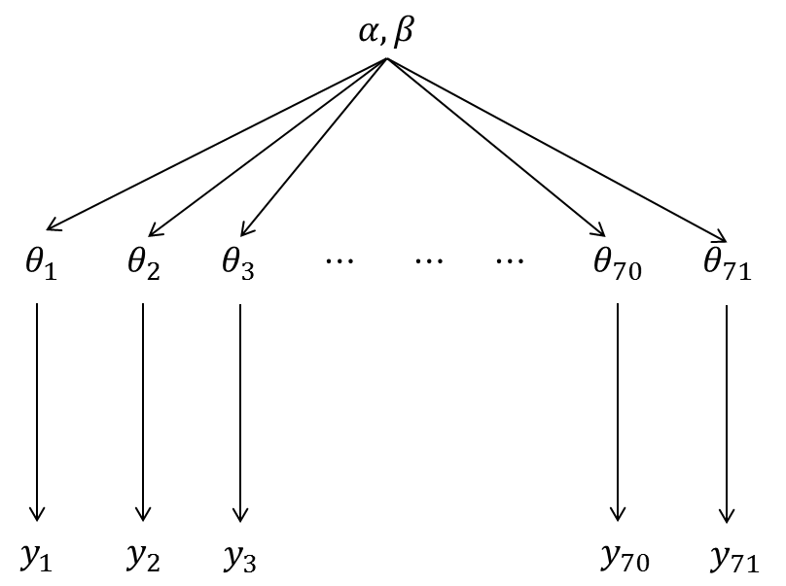
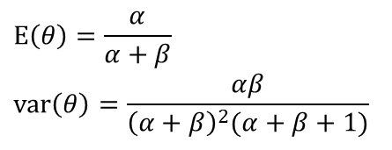

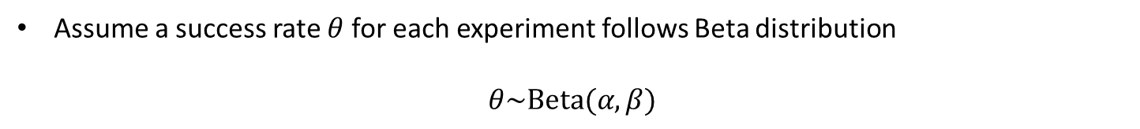

Motivating example : Drug test
Historical experimental results
:fixed
0/20 | 0/20 | 0/20 | 0/20 | 0/20 | 0/20 | 0/20 | 0/19 | 0/19 | 0/19
0/19 | 0/18 | 0/18 | 0/17 | 1/20 | 1/20 | 1/20 | 1/20 | 1/19 | 1/19
1/18 | 1/18 | 2/25 | 2/24 | 2/23 | 2/20 | 2/10 | 2/20 | 2/20 | 2/20
2/20 | 1/10 | 5/49 | 2/19 | 5/46 | 3/27 | 2/17 | 7/49 | 7/47 | 3/20
3/20 | 2/13 | 9/48 | 10/50 | 4/20 | 4/20 | 4/20 | 4/20 | 4/20 | 4/20
4/20 | 10/48 | 4/19 | 4/19 | 4/19 | 5/22 | 11/46 | 12/49 | 5/20 | 5/20
6/23 | 5/19 | 6/22 | 6/20 | 6/20 | 6/20 | 16/52 | 15/47 | 15/46 | 9/24
The observed sample mean of 70 values $\frac{y_{j}}{n_{j}}$ = 0.136
The observed sample standard deviation : 0.103
Assume a success rate $θ$ for each experiment follows Beta distribution
$$θ\sim Beta(α,β)$$
$$E\left(θ\right)=\frac{α}{α+β}$$
$$var\left(θ\right)=\frac{αβ}{{\left(α+β\right)}^{2}(α+β+1)}$$
Estimated parameters
$$\left(α,β\right)=(1.4, 8.6)$$
Now, we have prior distribution that is empirically estimated from data
$$p\left(θ\right)=Beta(θ|1,4,8.6)$$

Slide 17


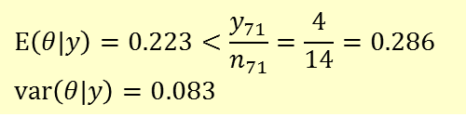

Motivating example : Drug test
Historical experimental results
:fixed
0/20 | 0/20 | 0/20 | 0/20 | 0/20 | 0/20 | 0/20 | 0/19 | 0/19 | 0/19
0/19 | 0/18 | 0/18 | 0/17 | 1/20 | 1/20 | 1/20 | 1/20 | 1/19 | 1/19
1/18 | 1/18 | 2/25 | 2/24 | 2/23 | 2/20 | 2/10 | 2/20 | 2/20 | 2/20
2/20 | 1/10 | 5/49 | 2/19 | 5/46 | 3/27 | 2/17 | 7/49 | 7/47 | 3/20
3/20 | 2/13 | 9/48 | 10/50 | 4/20 | 4/20 | 4/20 | 4/20 | 4/20 | 4/20
4/20 | 10/48 | 4/19 | 4/19 | 4/19 | 5/22 | 11/46 | 12/49 | 5/20 | 5/20
6/23 | 5/19 | 6/22 | 6/20 | 6/20 | 6/20 | 16/52 | 15/47 | 15/46 | 9/24
The observed sample mean of 70 values $\frac{y_{j}}{n_{j}}$ = 0.136
The observed sample standard deviation : 0.103
Now, we have prior distribution that is empirically estimated from data
$$p\left(θ\right)=Beta(θ|1.4,8.6)$$
Likelihood of the current observation (4 success from 14 tests)
$$p\left(y|θ\right)=Bin(4, 14)$$
Posterior distribution of the current experiment results
$$p\left(θ|y\right)=Beta(5.4, 18.6)$$
$$E\left(θ|y\right)=0.223<\frac{y_{71}}{n_{71}}=\frac{4}{14}=0.286$$
$$var\left(θ|y\right)=0.083$$
This is an empirical Bayes analysis
→ The point estimation on $α,β$ is arbitrary, and the point estimates ignore some uncertainties

Slide 18

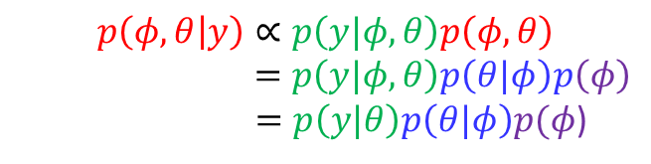


The full Bayesian treatment of the hierarchical model
$φ\sim$ $p(φ)$
: hyper priors
Not fixed ! -->
$φ=\left(α,β\right)$ : hyperparameters
$θ_{i}\sim Beta(α,β)$ : prior
The key characteristics of hierarchical Bayesian model is that $φ$ is not known and thus has its own prior distribution $p(φ)$
$$p\left(φ,θ | y\right)∝p\left(y|φ,θ\right)p\left(φ,θ\right)$$
$=p\left(y|φ,θ\right)p\left(θ|φ\right)p\left(φ\right)$
$=p\left(y|θ\right)p\left(θ|φ\right)p(φ$)
This model include the uncertainty in hyperparameters $φ$
The hyper parameter $φ$ affects $y$ only through parameters

Slide 19
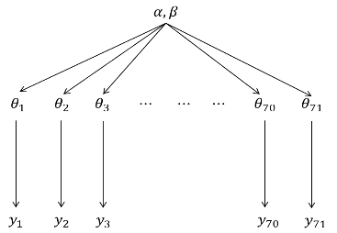
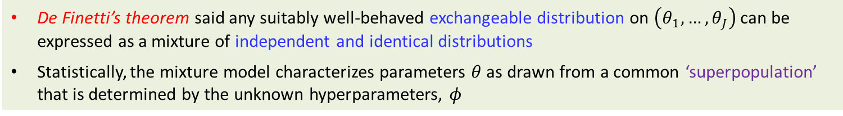
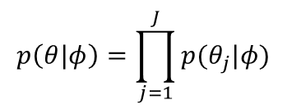
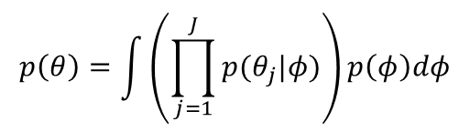
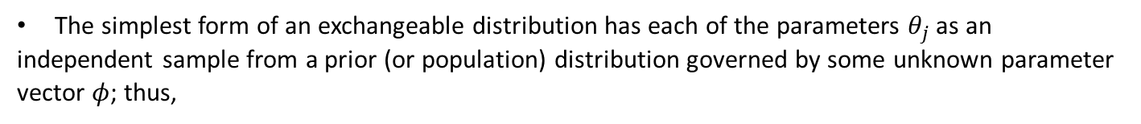

Exchangeability and hierarchical models
In order to create a joint probability model for all the parameters $θ=\left(θ_{1},…,θ_{J}\right)$, we use the crucial idea of exchangeability
The parameters $\left(θ_{1},…,θ_{J}\right)$ are exchangeable in their joint distribution if $p\left(θ_{1},…,θ_{J}\right)$ is
invariant to permutations of the indexes $\left(1,…,J\right)$
The simplest form of an exchangeable distribution has each of the parameters $θ_{j}$ as an
independent sample from a prior (or population) distribution governed by some unknown parameter vector $φ$; thus,
$$φ$$
$$p\left(θ|φ\right)=\prod_{j=1}^{J}{p(θ_{j}|φ)}$$
In general, $φ$ is unknown, so the distribution for $θ$ must average over the uncertainty in $φ$ :
$$p\left(θ\right)=\int_{ }^{ }{\left(\prod_{j=1}^{J}{p(θ_{j}|φ)}\right)p\left(φ\right)dφ}$$
De Finetti’s theorem said any suitably well-behaved exchangeable distribution on $\left(θ_{1},…,θ_{J}\right)$ can be expressed as a mixture of independent and identical distributions
Statistically, the mixture model characterizes parameters $θ$ as drawn from a common ‘superpopulation’ that is determined by the unknown hyperparameters, $φ$

Slide 20
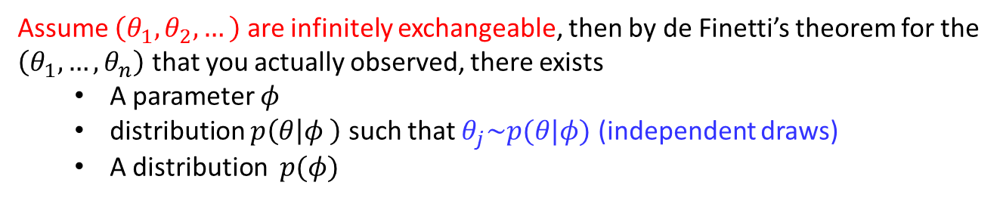
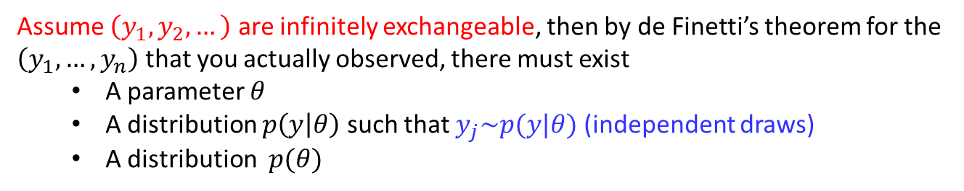

Exchangeability and hierarchical models
Assume $\left(y_{1}, y_{2},…\right)$ are infinitely exchangeable, then by de Finetti’s theorem for the $\left(y_{1},…,y_{n}\right)$ that you actually observed, there must exist
A parameter $θ$
A distribution $p\left(y | θ\right)$ such that $y_{j}\sim p(y|θ)$ (independent draws)
A distribution $p(θ)$
Assume $\left(θ_{1}, θ_{2},…\right)$ are infinitely exchangeable, then by de Finetti’s theorem for the $\left(θ_{1},…,θ_{n}\right)$ that you actually observed, there exists
A parameter $φ$
distribution $p\left(θ | φ \right)$ such that $θ_{j}\sim p(θ|φ)$ (independent draws)
A distribution $p(φ)$
Assume $φ=φ$ with $φ\sim p(φ)$
Although hierarchical models are typically written using the conditional interdependence notation, the assumptions underlying the model are exchangeability and functional forms for the priors

Slide 21

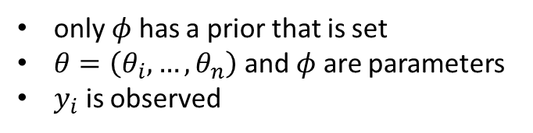
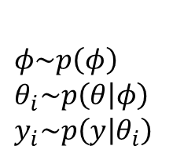



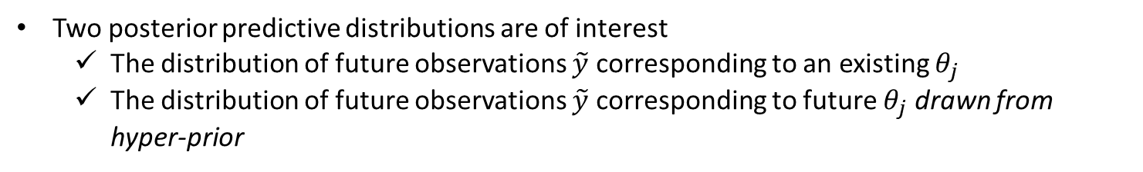



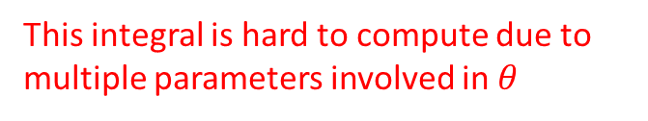




Procedure of inferencing for Bayesian hierarchical model
$$φ$$
$$φ\sim p\left(φ\right)$$
$$θ_{i}\sim p\left(θ | φ\right)$$
$$y_{i}\sim p\left(y | θ_{i}\right)$$
only $φ$ has a prior that is set
$θ=\left(θ_{i},…,θ_{n}\right)$ and $φ$ are parameters
$y_{i}$ is observed
$$θ_{1}$$
$$θ_{2}$$
$$⋯$$
$$θ_{n}$$
$$y_{1}$$
$$y_{2}$$
$$⋯$$
$$y_{n}$$
The joint posterior distribution of interest in hierarchical models is
$p\left(φ,θ | y\right)∝p\left(y|φ,θ\right)p\left(φ,θ\right)=p\left(y|θ\right)p\left(θ|φ\right)p(φ$)
We may be focused on marginal posteriors
$$p\left(θ | y\right)=\int_{φ}^{ }{p\left(φ,θ | y\right)dφ} or p\left(φ | y\right)=\int_{θ}^{ }{p\left(φ,θ | y\right)dθ}$$
This integral is hard to compute due to multiple parameters involved in $θ$
Two posterior predictive distributions are of interest
The distribution of future observations $\tilde{y}$ corresponding to an existing $θ_{j}$
The distribution of future observations $\tilde{y}$ corresponding to future $θ_{j}$ drawn from hyper-prior

Slide 22
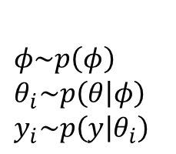
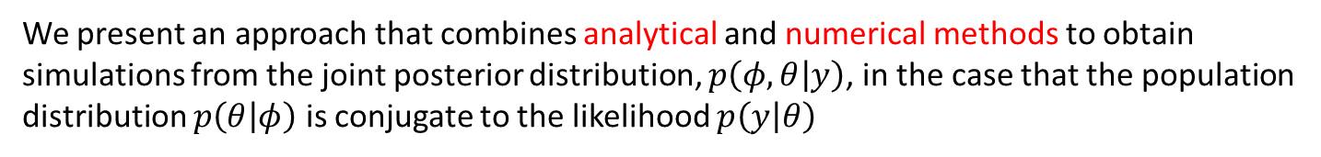
Procedure of inferencing for Bayesian hierarchical model
$$φ$$
$$φ\sim p\left(φ\right)$$
$$θ_{i}\sim p\left(θ | φ\right)$$
$$y_{i}\sim p\left(y | θ_{i}\right)$$
only $φ$ has a prior that is set
$θ=\left(θ_{i},…,θ_{n}\right)$ and $φ$ are parameters
$y_{i}$ is observed
$$θ_{1}$$
$$θ_{2}$$
$$⋯$$
$$θ_{n}$$
$$y_{1}$$
$$y_{2}$$
$$⋯$$
$$y_{n}$$
We present an approach that combines analytical and numerical methods to obtain simulations from the joint posterior distribution, $p\left(φ,θ | y\right)$, in the case that the population distribution $p\left(θ | φ\right)$ is conjugate to the likelihood $p\left(y | θ\right)$

Slide 23
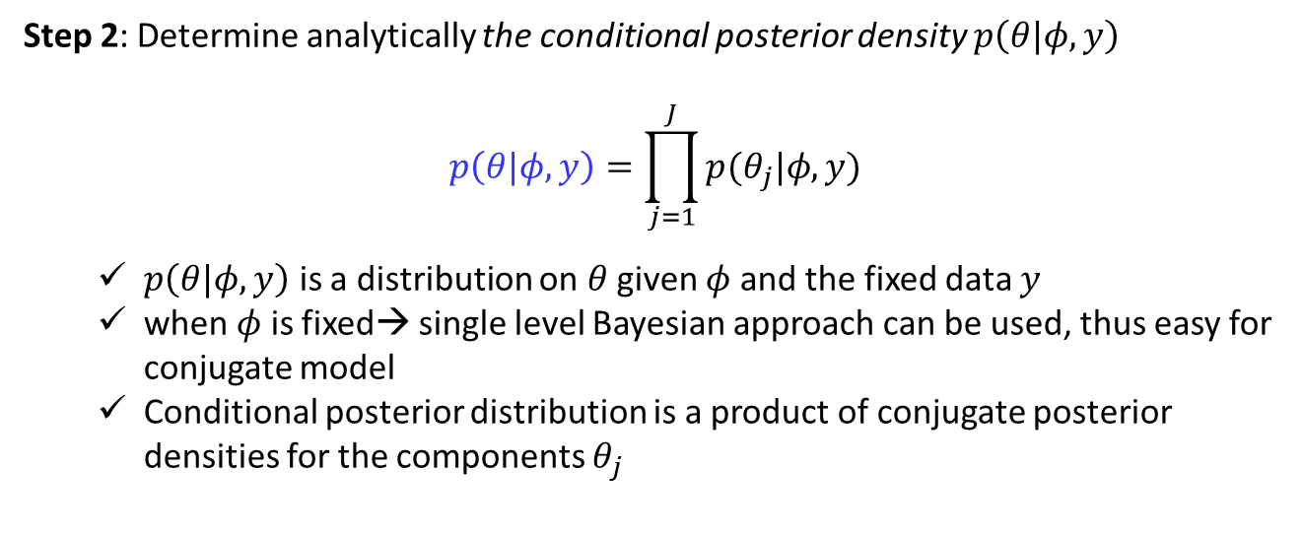
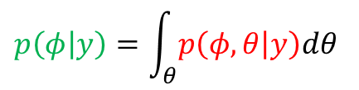

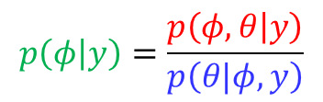
Procedure of inferencing for Bayesian hierarchical model
Analytical
Step 1: Write the joint posterior density $p\left(φ,θ | y\right)$
$$p\left(φ,θ | y\right)∝p\left(y|θ\right)p\left(θ|φ\right)p(φ\text{)}$$
(un-normalized form)
Step 2: Determine analytically the conditional posterior density $p\left(θ|φ,y\right)$
$$p\left(θ|φ,y\right)=\prod_{j=1}^{J}{p(θ_{j}|φ,y)}$$
$p\left(θ|φ,y\right)$ is a distribution on $θ$ given $φ$ and the fixed data $y$
when $φ$ is fixed→ single level Bayesian approach can be used, thus easy for conjugate model
Conditional posterior distribution is a product of conjugate posterior densities for the components $θ_{j}$
Step 3: Obtain marginal posterior distribution $p\left(φ | y\right)$ and estimate $φ$
$$p\left(φ | y\right)=\int_{θ}^{ }{p\left(φ,θ | y\right)dθ}$$
$$p\left(φ | y\right)=\frac{p\left(φ,θ | y\right)}{p\left(θ|φ,y\right)}$$
or
Brute force approach

Slide 24


Drawing simulations from the posterior distribution
Simulation
By factorization: $p\left(φ,θ | y\right)\text{=}p\left(θ | φ, y\right)p\left(φ | y\right)$
(Not Bayesian factorization)
Step 1: Draw the vector of hyperparameters $φ$ from its marginal posterior distribution, $p(φ|y)$
Step 2: Draw the parameter vector $θ$ from its conditional posterior distribution
$$p\left(θ|φ,y\right)=\prod_{j=1}^{J}{p(θ_{j}|φ,y)}$$
(fixed)
(The components $θ_{j}$ can be drawn independently, one at a time)
Step 3: Draw predictive values $\hat{y}$ from the posterior predictive distribution given the drawn $θ$
$$\hat{y}\sim p(\hat{y}|θ)$$
or draw future observations $\tilde{y}$ corresponding to future $θ_{j}$ drawn from hyper-prior $φ$
Repeat L times, and compute posterior distribution of any estimand or predictive quantity of interest

Slide 25



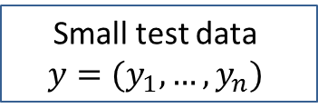
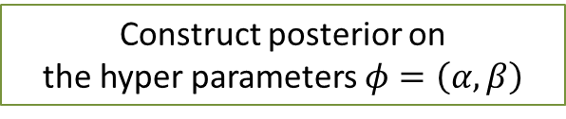
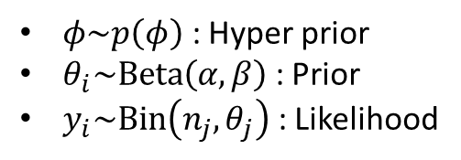
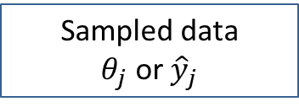

Bayesian analysis of conjugate hierarchical models-Procedure : Rat tumor example
Analytical approach
$φ\sim p\left(φ\right)$ : Hyper prior
$θ_{i}\sim Beta\left(α, β\right)$ : Prior
$y_{i}\sim Bin\left(n_{j}, θ_{j}\right)$ : Likelihood
$$p\left(φ | y\right)$$
Construct posterior on
the hyper parameters $φ=\left(α,β\right)$
$$p\left(φ | y\right)$$
$$p\left(θ | φ, y\right)$$
$$\hat{y}\sim p(\hat{y}|θ)$$
Small test data
$$y=(y_{1},…,y_{n})$$
Sampled data
$θ_{j}$ or ${\hat{y}}_{j}$
Simulational approach

Slide 26

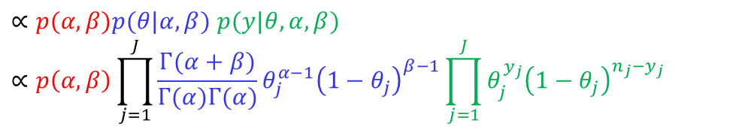



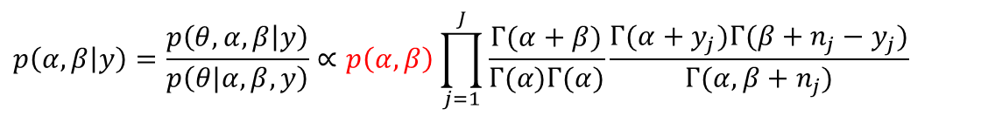
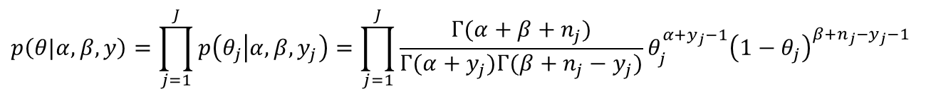
Bayesian analysis of conjugate hierarchical models-Procedure : Rat tumor example
Analytical
Models are given:
$$\left(α,β\right)\sim p\left(α,β\right)$$
: hyper prior
$$θ_{j}\sim Beta(α,β)$$
: Prior
$y_{j}\sim Bin(n_{j}$, $θ_{j})$
: sampling distribution
Step 1 (joint posterior distribution):
$$p(θ,α,β|y)$$
$∝p(α,β)p(θ|α,β)$ $p(y|θ,α,β)$
$$∝p\left(α,β\right)\prod_{j=1}^{J}{\frac{Γ(α+β)}{Γ(α)Γ(α)}θ_{j}^{α−1}{\left(1−θ_{j}\right)}^{β−1}}\prod_{j=1}^{J}{θ_{j}^{y_{j}}{\left(1−θ_{j}\right)}^{{n_{j}−y}_{j}}}$$
Step 2 (conditional posterior distribution):
$$p\left(θ|α,β,y\right)=\prod_{j=1}^{J}{p\left(θ_{j} | α,β,y_{j}\right)=\prod_{j=1}^{J}{\frac{Γ(α+β+n_{j})}{Γ(α+y_{j})Γ(β+{n_{j}−y}_{j})}θ_{j}^{α+y_{j}−1}{\left(1−θ_{j}\right)}^{β+{n_{j}−y}_{j}−1}}}$$
(Given the hyper-parameters ($α,β),$ it is just a single layer Bayesian posterior)
Step 3 (marginal posterior distribution):
$$p\left(α,β | y\right)=\frac{p\left(θ,α,β | y\right)}{p\left(θ|α,β,y\right)}∝p\left(α,β\right)\prod_{j=1}^{J}{\frac{Γ(α+β)}{Γ(α)Γ(α)}\frac{Γ(α+y_{j})Γ(β+n_{j}−y_{j})}{Γ(α,β+n_{j})}}$$

Slide 27



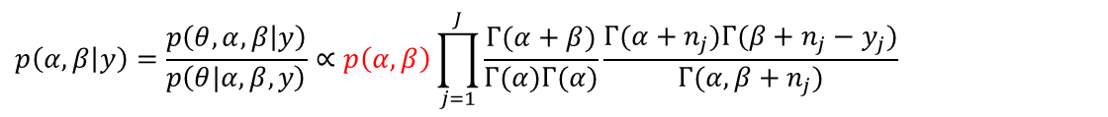


Bayesian analysis of conjugate hierarchical models-Procedure : Rat tumor example
Sampling Approach
Models are given:
$$\left(α,β\right)\sim p\left(α,β\right)$$
: hyper prior
$$θ_{j}\sim Beta(α,β)$$
: Prior
$y_{j}\sim Bin(n_{j}$, $θ_{j})$
: sampling distribution
Compute the posterior distribution using sampling methods
$$p\left(θ,α,β | y\right)=p\left(θ|α,β,y\right)p\left(α,β | y\right)$$
Repeat $L$ times $(i=1,…,L)$
Sample $\left(α^{\left(i\right)},β^{(i)}\right)$ from
$$p\left(α,β | y\right)=\frac{p\left(θ,α,β | y\right)}{p\left(θ|α,β,y\right)}∝p\left(α,β\right)\prod_{j=1}^{J}{\frac{Γ(α+β)}{Γ(α)Γ(α)}\frac{Γ(α+n_{j})Γ(β+n_{j}−y_{j})}{Γ(α,β+n_{j})}}$$
Sample $θ^{(i)}$ from
$$p\left(θ|α^{\left(i\right)},β^{(i)},y\right)=\prod_{j=1}^{J}{p\left(θ_{j} | α^{\left(i\right)},β^{(i)},y_{j}\right)=\prod_{j=1}^{J}{\frac{Γ(α^{\left(i\right)}+β^{(i)}+n_{j})}{Γ(α^{\left(i\right)}+y_{j})Γ(β^{(i)}+{n_{j}−y}_{j})}θ_{j}^{α^{\left(i\right)}+y_{j}−1}{\left(1−θ_{j}\right)}^{β^{(i)}+{n_{j}−y}_{j}−1}}}$$
$$θ^{(i)}=\left(θ_{1}^{(i)},…,θ_{J}^{(i)}\right)$$
We can then have $L$ samples : $\left(α^{\left(1\right)},β^{\left(1\right)},θ^{(1)}\right),…,$ $\left(α^{\left(L\right)},β^{\left(L\right)},θ^{(L)}\right)$

Slide 28
Bayesian analysis of conjugate hierarchical models-Procedure : Rat tumor example
Jupyter Demo Simulation

Slide 29

Normal model with exchangeable parameters
Fixed hyper-parameter
Shared hyper-parameters
Group parameters
$$θ_{1}$$
$$θ_{2}$$
$$θ_{j}$$
$y_{11},y_{21}$,…, $y_{n1}$
$y_{12},y_{22}$,…, $y_{n2}$
$y_{1j},y_{2j}$,…, $y_{nj}$

Slide 30













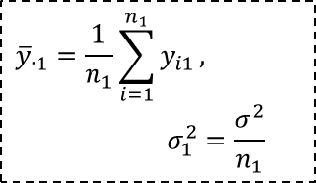



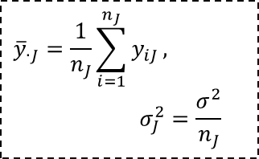






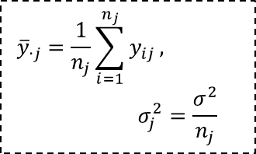




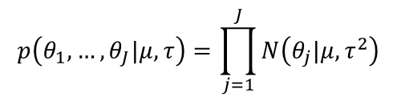

Normal model with exchangeable parameters
Fixed hyper-parameter
$$(μ,τ)$$
$$\left(μ,τ\right)\sim p\left(μ,τ\right)$$
$$p\left(θ_{1},…,θ_{J}|μ,τ\right)=\prod_{j=1}^{J}{N\left(θ_{j}|μ,τ^{2}\right)}$$
$$θ_{1}$$
$$⋯$$
$$θ_{j}$$
$$⋯$$
$$θ_{J}$$
$$θ_{j}\sim N(μ,τ^{2})$$
$θ_{j}$ are conditionally independent given $\left(μ,τ\right)$
$$y_{11}$$
$$⋯$$
$$y_{i1}$$
$$⋯$$
$$y_{n_{1}1}$$
$$y_{1j}$$
$$⋯$$
$$y_{ij}$$
$$⋯$$
$$y_{n_{j}j}$$
$$y_{1J}$$
$$⋯$$
$$y_{iJ}$$
$$⋯$$
$$y_{n_{J}J}$$
$$y_{ij}|θ_{j}\sim N(θ_{j},σ^{2})$$
$σ^{2}:$ Known variance
$${\overline{y}}_{∙1}=\frac{1}{n_{1}}\sum_{i=1}^{n_{1}}{y_{i1}}, σ_{1}^{2}=\frac{σ^{2}}{n_{1}}$$
$${\overline{y}}_{∙j}=\frac{1}{n_{j}}\sum_{i=1}^{n_{j}}{y_{ij}}, σ_{j}^{2}=\frac{σ^{2}}{n_{j}}$$
$${\overline{y}}_{∙J}=\frac{1}{n_{J}}\sum_{i=1}^{n_{J}}{y_{iJ}}, σ_{J}^{2}=\frac{σ^{2}}{n_{J}}$$
Observed data are normally distributed with a different mean $θ_{j}$ for each ‘group’ with known observation variance $σ^{2}$
Normal population distribution for the group mean $θ_{j}\sim N(μ,τ^{2})$

Slide 31















Normal model with exchangeable parameters
$$(μ,τ)$$
$$\left(μ,τ\right)\sim p\left(μ,τ\right)$$
$$p\left(θ_{1},…,θ_{J}|μ,τ\right)=\prod_{j=1}^{J}{N\left(θ_{j}|μ,τ^{2}\right)}$$
$$θ_{1}$$
$$⋯$$
$$θ_{j}$$
$$⋯$$
$$θ_{J}$$
$$θ_{j}\sim N(μ,τ^{2})$$
$θ_{j}$ are conditionally independent given $\left(μ,τ\right)$
$${\overline{y}}_{∙1}, σ_{1}^{2}$$
$${\overline{y}}_{∙j}, σ_{j}^{2}$$
$${\overline{y}}_{∙J}, σ_{J}^{2}$$
$${\overline{y}}_{∙j}|θ_{j}\sim N(θ_{j},σ_{j}^{2})$$
Distribution on sufficient statistics
Observed data are normally distributed with a different mean for each ‘group’ with known observation variance
Normal population distribution for the group mean
Write the likelihood for each $θ_{j}$ using the sufficient statistics, ${\overline{y}}_{∙j}$

Slide 32


Normal model with exchangeable parameters
Models are given:
: hyper prior
$\left(μ,τ\right)\sim p\left(μ,τ\right)=p\left(μ|τ\right)p(τ)∝p\left(τ\right)$
$θ_{j}\sim N\left(μ,τ^{2}\right)→p\left(θ | μ,τ\right)=\prod_{j=1}^{J}{N\left(θ_{j}|μ,τ^{2}\right)}$
(parameters are conditionally independent given hyper parameters
$y_{.j}\sim N\left(θ_{j},σ_{j}^{2}\right)→p\left(y | θ\right)=\prod_{j=1}^{J}{N\left({\overline{y}}_{∙j}|θ_{j},σ_{j}^{2}\right)}$
(data are conditionally independent given parameter)
: Prior
: sampling distribution
Analytical
$p\left(θ,μ,τ | y\right)$ : The joint posterior distribution
$p\left(θ|μ,τ,y\right)$ : The conditional posterior distribution
$p\left(μ,τ | y\right)→p\left(μ | τ,y\right)p(τ|y)$ : The marginal posterior distribution
Sampling
To derive the posterior computational methods, we factorize the posterior as :
(Not Bayesian approach)
(1)
(2)
(3)
$$p\left(θ,μ,τ | y\right)=p\left(τ | y\right)p\left(μ|τ, y\right)p\left(θ|μ,τ,y\right)$$

Slide 33










Procedure of inferencing for Bayesian hierarchical model
Analytical
$$σ_{j}^{2}=\frac{σ^{2}}{n_{j}}$$
Step 1: Write the joint posterior density $p\left(μ,τ,θ | y\right)$
$p\left(μ,τ, θ | y\right)∝p(μ,τ\text{)}$ $p\left(θ|μ,τ\right)p\left(y|θ\right)$
$$=p(μ,τ\text{)}\prod_{j=1}^{J}{N(θ_{j}|μ,τ^{2})}\prod_{j=1}^{J}{N\left({{\overline{y}}_{.j}|θ}_{j},σ_{j}^{2}\right) }$$
(un-normalized form)
$$\left(σ_{j}^{2}=\frac{σ^{2}}{n_{j}}\text{is} \text{known}\right)$$
Step 2: Determine analytically the conditional posterior density $p\left(θ|μ,τ,y\right)$
$$p\left(θ|μ,τ,y\right)=\prod_{j=1}^{J}{p(θ_{j}|μ,τ,y)}=\prod_{j=1}^{J}{N({θ_{j}|\hat{θ}}_{j},V_{j}) }$$
$$\frac{1}{σ_{j}^{2}}=\frac{n}{ σ^{2}}$$
Recall posterior of Gaussian Prior + Gaussian Likelihood
$${\hat{θ}}_{j}=\frac{\frac{1}{σ_{j}^{2}}{\overline{y}}_{∙j}+\frac{1}{τ^{2}}μ}{\frac{1}{σ_{j}^{2}}+\frac{1}{τ^{2}}}$$
$$V_{j}=\frac{1}{\frac{1}{σ_{j}^{2}}+\frac{1}{τ^{2}}}$$
$$θ_{j}\sim N(μ,τ^{2})$$
+
$$y_{ij}\sim N(θ_{j},σ^{2})$$
=
$$θ_{j}|μ,τ,y\sim N({\hat{θ}}_{j},V_{j})$$
Prior
sampling distribution
posterior
Given hyper parameters, it require one layer posterior distribution

Slide 34











Procedure of inferencing for Bayesian hierarchical model
Analytical
Step 3: Obtain marginal posterior distribution $p\left(μ,τ | y\right)$
$$p\left(μ,τ | y\right)=\int_{θ}^{ }{p\left(μ,τ, θ | y\right)dθ}$$
$$p\left(μ,τ | y\right)=\frac{p\left(μ,τ, θ | y\right)}{p\left(θ|μ,τ,y\right)}$$
or
For the hierarchical normal model, we can simply consider the information supplied by the data about the hyper parameters directly
$$p\left(μ,τ | y\right)∝p\left(μ,τ\right)p\left(y|μ,τ\right)$$
$$=p\left(μ,τ\right)\prod_{j}^{J}{N({\overline{y}}_{i}|{μ,σ}_{j}^{2}+τ^{2})}$$
$$∵p\left({\overline{y}}_{i}|μ,τ\right)\sim N({\overline{y}}_{i}|μ, σ_{j}^{2}+τ^{2})$$
Further factorization $p\left(μ,τ | y\right)=p\left(μ | τ,y\right)p\left(τ | y\right)$
Step 3-1: posterior distribution of $μ$ given $τ$
$$\hat{μ}=\frac{\sum_{j=1}^{J}{\frac{1}{σ_{j}^{2}+τ^{2}}{\overline{y}}_{∙j}}}{\sum_{j=1}^{J}{\frac{1}{σ_{j}^{2}+τ^{2}}}}$$
$$V_{μ}^{−1}=\sum_{j=1}^{J}{\frac{1}{σ_{j}^{2}+τ^{2}}}$$
$$p\left(μ | τ,y\right)=N(μ|\hat{μ,} V_{μ})$$
and
Step 3-2: posterior distribution of $τ$
$$p\left(τ | y\right)=\frac{p\left(μ,τ | y\right)}{p\left(μ | τ,y\right)}$$
$$∝\frac{p\left(τ\right)\prod_{j}^{J}{N({\overline{y}}_{i}|{μ,σ}_{j}^{2}+τ^{2})}}{N\left(μ | \hat{μ,} V_{μ}\right) }$$
$$∝p\left(τ\right)V_{μ}^{\frac{1}{2}}\prod_{j=1}^{J}{{\left(σ_{j}^{2}+τ^{2}\right)}^{−1/2}\exp\left(−\frac{{\left({\overline{y}}_{∙j}−\hat{μ}\right)}^{2}}{2\left(σ_{j}^{2}+τ^{2}\right)}\right) }$$

Slide 35








Computation of Posterior
Simulation
Different factorization for simulation:
$$p\left(θ,μ,τ | y\right)=p\left(θ | μ,τ, y\right)p\left(μ,τ|y\right)$$
$$p\left(θ,μ,τ | y\right)=p\left(θ|μ,τ,y\right)p\left(μ|τ, y\right)p\left(τ | y\right)$$
(3)
(2)
(1)
Step 1
$$p\left(τ|y\right)=\frac{p\left(μ,τ|y\right)}{p\left(μ|τ,y\right)}∝\frac{p\left(τ\right)\prod_{j=1}^{J}{N\left(μ|θ_{j},σ_{j}^{2}+τ^{2}\right)}}{N\left(\hat{μ },V_{μ}\right)}∝p\left(τ\right)V_{μ}^{\frac{1}{2}}\prod_{j=1}^{J}{{\left(σ_{j}^{2}+τ^{2}\right)}^{−1/2}\exp\left(−\frac{{\left({\overline{y}}_{∙j}−\hat{μ}\right)}^{2}}{2\left(σ_{j}^{2}+τ^{2}\right)}\right) }$$
Step 2
$$\hat{μ }=\frac{\sum_{j=1}^{J}{\frac{1}{σ_{j}^{2}+τ^{2}}{\overline{y}}_{∙j}}}{\sum_{j=1}^{J}{\frac{1}{σ_{j}^{2}+τ^{2}}}}$$
$$p\left(μ | τ,y\right)=N\left(μ|\hat{μ },V_{μ}\right)$$
$$V_{μ}=\frac{1}{\sum_{j=1}^{J}{\frac{1}{σ_{j}^{2}+τ^{2}}}}$$
and
Step 3
$${\hat{θ}}_{j}=\frac{\frac{1}{σ_{j}^{2}}{\overline{y}}_{∙j}+\frac{1}{τ^{2}}μ}{\frac{1}{σ_{j}^{2}}+\frac{1}{τ^{2}}}$$
$$p\left(θ_{j}|μ,τ,y\right)\sim N({\hat{θ}}_{j},V_{j})$$
and
$$V_{j}=\frac{1}{\frac{1}{σ_{j}^{2}}+\frac{1}{τ^{2}}}$$

Slide 36
















Posterior Predictive distribution
Sampling using given the posterior distribution of the parameters
$$p\left(θ,μ,τ | y\right)$$
$$(μ,τ)$$
$$p\left(τ|y\right)$$
Bayesian Inference
Sampling
$$p\left(μ | τ,y\right)$$
$$θ_{1}$$
$$⋯$$
$$θ_{j}$$
$$⋯$$
$$θ_{J}$$
$$p\left(θ_{j}|μ,τ,y\right)$$
$$p\left(y_{ij}|θ_{j}\right)$$
$${\overline{y}}_{∙1}, σ_{1}^{2}$$
$${\overline{y}}_{∙j},σ_{j}^{2}$$
$${\overline{y}}_{∙J},σ_{J}^{2}$$
Future data $\tilde{y}$ from the current set of batches, with means $θ=\left(θ_{1},…,θ_{J}\right)$
First draw $θ=\left(θ_{1},…,θ_{J}\right)$ from $p\left(θ,μ,τ | y\right)$ and sample data $\tilde{y}$ using $p\left(y_{ij}|θ_{j}\right)$
Future data $\tilde{y}$ from $\tilde{J}$ future batches, with means $\tilde{θ}=\left({\tilde{θ}}_{1},…,{\tilde{θ}}_{\tilde{J}}\right)$
First draw $(μ,τ)$ from $p\left(θ,μ,τ | y\right)$
Second draw $\tilde{J}$ new parameters $\tilde{θ}=\left({\tilde{θ}}_{1},…,{\tilde{θ}}_{\tilde{J}}\right)$ from $p\left({\tilde{θ}}_{j}|μ,τ\right)$
Third, draw $\tilde{y}$ given $\tilde{θ}$ from the data distribution $p\left(y_{ij}|{\tilde{θ}}_{j}\right)$

Slide 37


Example: Parallel experiments in eight schools
A study was performed for the Educational Testing Service to analyze the effects of special coaching programs on test scores in eight schools.
There was no prior reason to believe that any of the eight programs was more effective than any other or that some were more similar in effect to each other than to any other
The estimates $y_{j}$ and $σ_{j}$are obtained by independent experiments

Slide 38













Example: Parallel experiments in eight schools
Independent estimate
The effects of special coaching programs on test scores.
The estimates $y_{j}$ are obtained by independent experiments and have approximately normal distribution
$$θ_{1}$$
$$⋯$$
$$θ_{j}$$
$$⋯$$
$$θ_{8}$$
$$y_{j, }σ_{j}^{2}$$
$$y_{j, }σ_{j}^{2}$$
$$y_{8, }σ_{8}^{2}$$
$$y_{j}\sim N(θ_{j},σ_{j}^{2})$$
$σ^{2}:$ Known variance
$$p\left(A>28 | θ\right)=0.5?$$

Slide 39








Example: Parallel experiments in eight schools
Pooled estimate
All experiments have the same effect and produce independent
estimates of this common effect
Treat the data as eight normally distributed observations
with know variances
$$θ_{j }\sim N(μ,τ^{2})$$
$$θ_{j}$$
$$θ$$
$$θ$$
$$y_{j, }σ_{j}^{2}$$
$$y_{j, }σ_{j}^{2}$$
$$y_{8, }σ_{8}^{2}$$
$$y_{j}\sim N(θ,σ_{j}^{2})$$
$σ^{2}:$ Known variance
$$μ=\frac{\sum_{j=1}^{J}{\frac{1}{σ_{j}^{2}}}y_{j }}{\sum_{j=1}^{J}{\frac{1}{σ_{j}^{2}}}}=7.7$$
$$τ^{2}=\frac{1}{\sum_{j=1}^{J}{\frac{1}{σ_{j}^{2}}}}=16.6,σ=4.1$$
$$p\left(A<7.7 | θ\right)=0.5?$$

Slide 40













Example: Parallel experiments in eight schools
Hierarchical Bayesian Model
We would like a compromise that combines information from all eight experiments without assuming all the $θ_{j}$’s to be equal.
$$(μ,τ)$$
$$\left(μ,τ\right)\sim p\left(μ,τ\right)$$
$$θ_{1}$$
$$θ_{j}\sim N(μ,τ^{2})$$
$$⋯$$
$$θ_{j}$$
$$⋯$$
$$θ_{8}$$
$$y_{j, }σ_{j}^{2}$$
$$y_{j, }σ_{j}^{2}$$
$$y_{8, }σ_{8}^{2}$$
$$y_{j}\sim N(θ_{j},σ_{j}^{2})$$
$σ^{2}:$ Known variance

Slide 41










Example: Parallel experiments in eight schools
Sampling procedure
$$p\left(τ|y\right)∝p\left(τ\right)V_{μ}^{\frac{1}{2}}\prod_{j=1}^{J}{{\left(σ_{j}^{2}+τ^{2}\right)}^{−1/2}\exp\left(−\frac{{\left({\overline{y}}_{∙j}−\hat{μ}\right)}^{2}}{2\left(σ_{j}^{2}+τ^{2}\right)}\right) }$$
Sample $τ$ given data $y$
$$E\left(θ|τ,y\right)$$
$$p\left(θ|τ,y\right)$$
$$=\int_{μ}^{ }{p\left(θ,μ|τ,y\right)dμ}$$
$$=\int_{μ}^{ }{p\left(θ|μ,τ,y\right)p\left(μ|τ,y\right)dμ}$$
Separate
Pooling
Sample $θ$ given $τ$ and data $y$
$$std\left(θ|τ,y\right)$$

Slide 42


Example: Parallel experiments in eight schools
Results from the posterior distribution estimated using the sampled data
The Bayesian probability that the effect in school A is as large as 28 points:
Individual test: 50% → Bayesian : less than 10%
What is the maximum $\{θ_{j}\}$?
What is $Pr(θ_{3}$>$θ_{5}|y)$?
Hierarchical model is flexible enough to adapt to the data, thereby providing posterior inferences that account for the partial pooling as well as uncertainty in the hyper parameters

